Slide 1
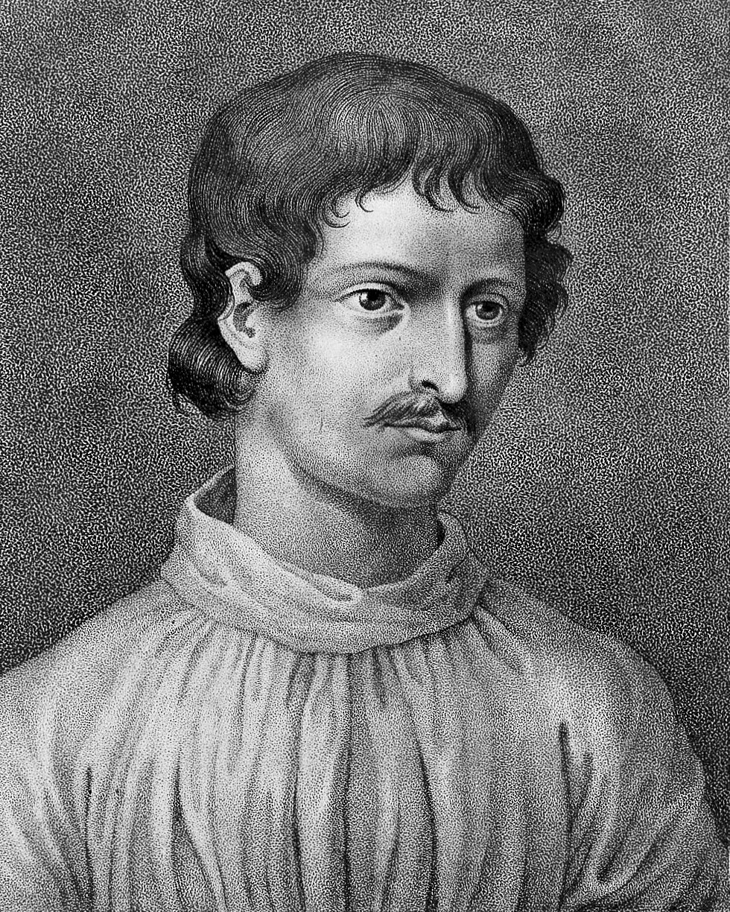
The genome as a mosaic. Clustering individuals using allele frequency and haplotype-based methods applied to human and microbial datasets. Identifying admixture using patterns of LD – its sources and its timings
Oscar Lao
Giordano Bruno. 1548 – 1600. Nola, Kingdom of Naples

Slide 2
How to learn the “model”
“Model that generates the data”
Conceptual
Unseen
Generalizes any dataset
“Observed data”
Physical realization of the model (quantified features)
Stochastic noise (it is not deterministic)
Each dataset has particular features not shared with other datasets -> Each dataset is UNIQUE
“Statistical model”
Statistical realization of the model
Algorithms

Slide 3


In unsupervised modelling
Model rules are explicitly stated by the human (“Two items are from the same category if they have a distance smaller than…”, “if data is generated under this statistical distribution then my items must be classified in…”)
“Model that generates the data”
Conceptual
Unseen
Generalizes any dataset
“Human defines the rules that generated the concept”
“Observed data”
Physical realization of the model (quantified features)
Stochastic noise (it is not deterministic)
Each dataset has particular features not shared with other datasets -> Each dataset is UNIQUE
“Statistical model”
Statistical realization of the model
Algorithms

Slide 4
In unsupervised modelling
Model rules are explicitly stated by the human (“Two items are from the same category if they have a distance smaller than…”, “if data is generated under this statistical distribution then my items must be classified in…”)
Where do they come from?

Slide 5
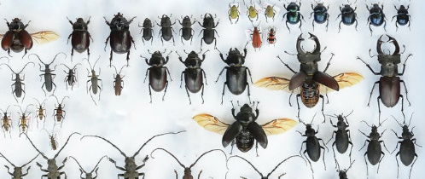
In unsupervised modelling
Unsupervised
Classification
Requires a explicit model that explains the rules how the data is generated
“Explicit model” -> prior knowledge has been used to define the model (Hume)
There is an algorithm that implements that explicit model. We can do future predictions
Prior knowledge: “Things that look similar share a common origin”
Similar things can be clustered together

Slide 6
When to use unsupervised learning?
Exploratory analyses
Gain information about the inner structure of the data
Dimensionality reduction
Indirectly, to test hypotheses
…

Slide 7
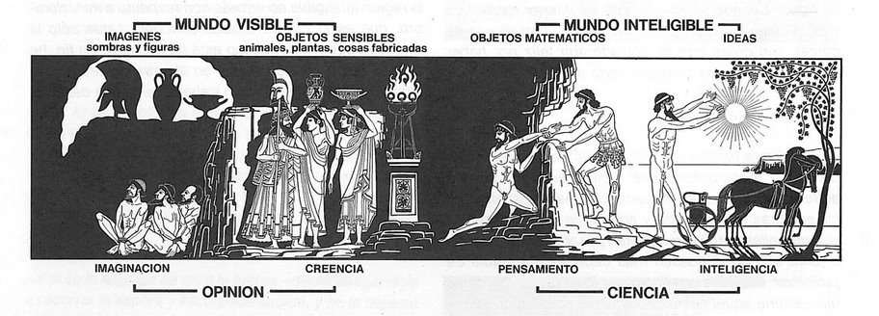
Detecting population substructure is unsupervised modelling
How much can be detected and how much there is. The two sides of the same coin
Plato’s cave myth
Notes:
When we talk about inference, we have to distinguish between two different aspects. How much inherent difference there is in the data and how sensitive is the method do we apply to detect such differences.

Slide 8
Detecting population substructure is unsupervised modelling
How much can be detected and how much there is. The two sides of the same coin
Plato’s cave myth
CHANGE THE ALGORITHM/HOW DATA ARE DEFINED FOR DETECTING POPULATION SUBSTRUCTURE
Notes:
When we talk about inference, we have to distinguish between two different aspects. How much inherent difference there is in the data and how sensitive is the method do we apply to detect such differences.

Slide 9
Feature Selection vs feature Extraction
Feature extraction approach -> features are projected into a new space with lower dimensionality.
Principle Component Analysis (PCA),
Linear Discriminant Analysis (LDA)
Singular Value Decomposition (SVD)
…
Feature Selection approach -> Identify a small subset of features that minimize redundancy and maximize relevance to the target (i.e., class label). FS ascertains features that are capable of discriminating samples that belong to different classes
Information Gain
Relief
Chi Squares
Fisher Score
Lasso
…

Slide 10
Feature Selection vs feature Extraction
Feature extraction approach -> features are projected into a new space with lower dimensionality.
Principle Component Analysis (PCA),
Linear Discriminant Analysis (LDA)
Singular Value Decomposition (SVD)
…
Feature Selection approach -> Identify a small subset of features that minimize redundancy and maximize relevance to the target (i.e., class label). FS ascertains features that are capable of discriminating samples that belong to different classes
Information Gain
Relief
Chi Squares
Fisher Score
Lasso
…
Allows learning performance but interpretability of WHY the model Works is not so easy to identify
Allows better interpretability but pattern identification is constrained to the actual values of the ascertained features

Slide 11
Feature extraction
Can we visualize the relationship between individuals given a SNV profile?

Slide 12
Feature extraction
Can we visualize the relationship between individuals given a SNV profile?
Can we reduce the dimensionality of the genetic data so we can visualize the genetic relationships of individuals?
Can we identify any pattern in this reduced space?

Slide 13
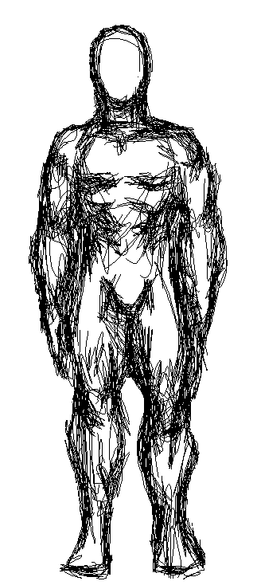
Feature extraction
Assumptions of the model: “all ancestral populations are equally related”
Assumptions of the model: “Features are (linear/non-linear correlated)”
K = 4
α4
α3
α2
α1
Dim2
 | snp1 | snp2 | snp3 | snp4 | snp5 | snp6 | … | snpn
I1 | 0 | 1 | 2 | 1 | 0 | 0 |  | 1
I2 | 0 | 0 | 2 | 0 | 0 | 2 |  | 1
I3 | 1 | 1 | 2 | 0 | 0 | 2 |  | 0
I4 | 0 | 1 | 2 | 0 | 1 | 2 |  | 0
I5 | 1 | 1 | 2 | 0 | 1 | 2 |  | 1
…
Im | 2 | 0 | 1 | 0 | 1 | 2 |  | 2
Dim1
Algorithmic ancestry estimation
AA = 0
AB = 1
BB = 2
Model-based ancestry
estimation

Slide 14
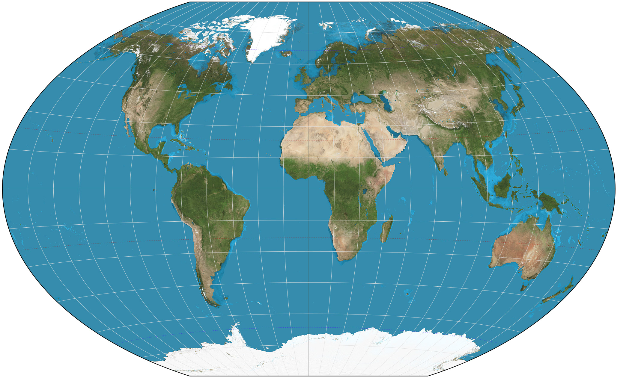
Feature extraction
Assumptions of the model: “genetic relationships are a function of 2D space”
K = 4
α4
α3
α2
α1
 | snp1 | snp2 | snp3 | snp4 | snp5 | snp6 | … | snpn
I1 | 0 | 1 | 2 | 1 | 0 | 0 |  | 1
I2 | 0 | 0 | 2 | 0 | 0 | 2 |  | 1
I3 | 1 | 1 | 2 | 0 | 0 | 2 |  | 0
I4 | 0 | 1 | 2 | 0 | 1 | 2 |  | 0
I5 | 1 | 1 | 2 | 0 | 1 | 2 |  | 1
…
Im | 2 | 0 | 1 | 0 | 1 | 2 |  | 2
Algorithmic geographic estimation
AA = 0
AB = 1
BB = 2
Model-based ancestry
estimation

Slide 15
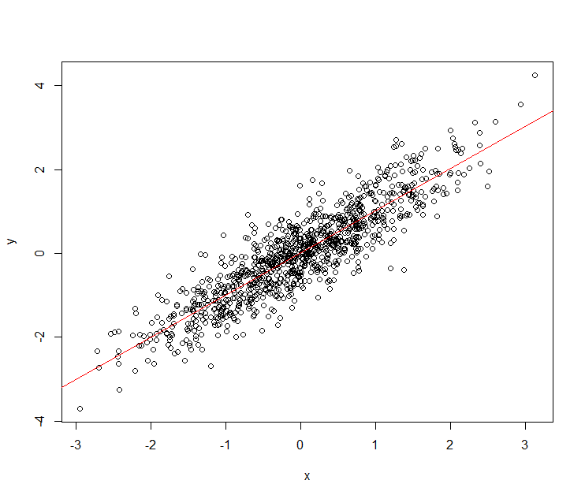
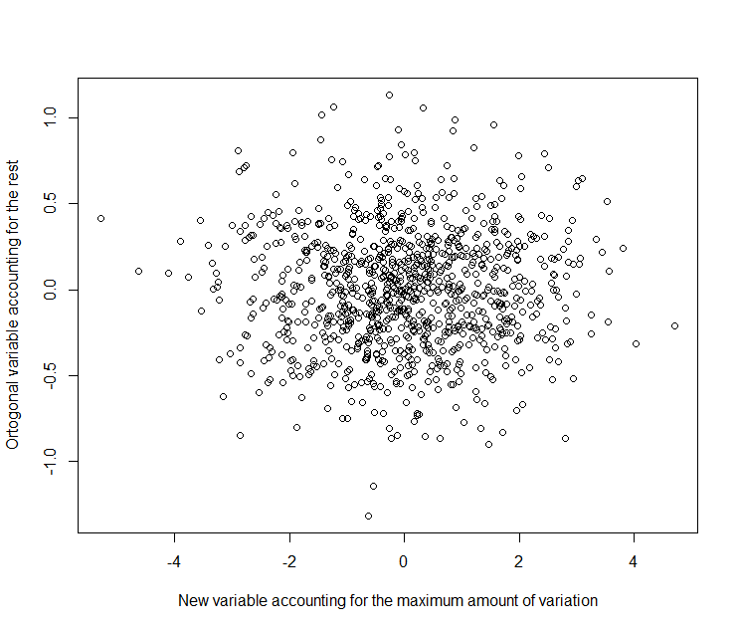
Feature Extraction: Not all variables are independent
Minimum axis of differentiation
Maximum axis of differentiation

Slide 16
Feature extraction: Change how data are defined
Modify how data are defined. For exemple, data are defined NOT in terms of SNPs, but in terms of identical fragments (incorporate LD)
Patterns become more obvious
Dim2
Identical By Descent | I1 | I2 | I3 | ... | Im
I1
I2
I3
...
Im
 | snp1 | snp2 | snp3 | snp4 | snp5 | snp6 | … | snpn
I1 | 0 | 1 | 2 | 1 | 0 | 0 |  | 1
I2 | 0 | 0 | 2 | 0 | 0 | 2 |  | 1
I3 | 1 | 1 | 2 | 0 | 0 | 2 |  | 0
I4 | 0 | 1 | 2 | 0 | 1 | 2 |  | 0
I5 | 1 | 1 | 2 | 0 | 1 | 2 |  | 1
…
Im | 2 | 0 | 1 | 0 | 1 | 2 |  | 2
LD
Dim1
Feature extraction algorithm
AA = 0
AB = 1
BB = 2

Slide 17
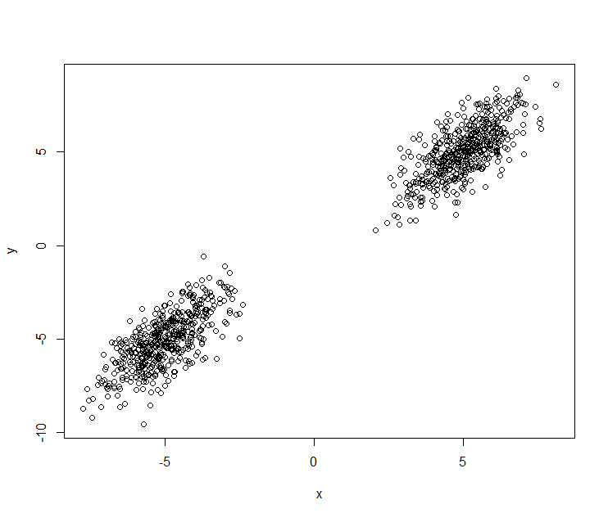
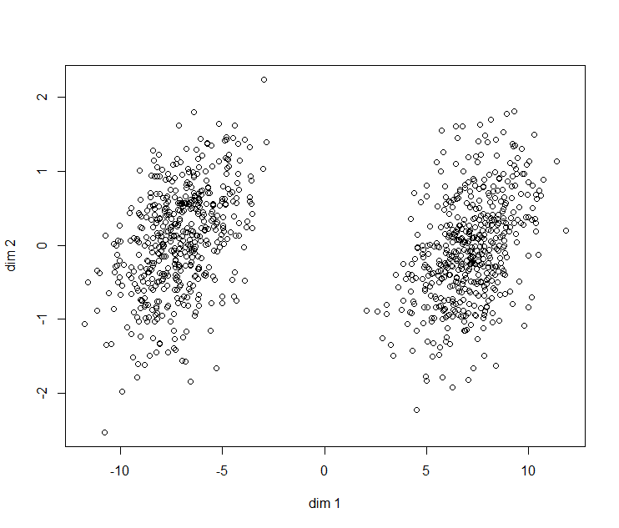
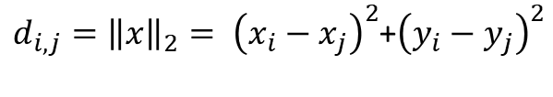
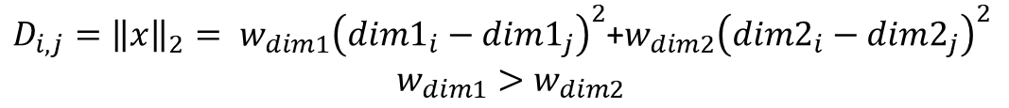
A coordinate analysis approach (classical multidimensional scaling)
$D_{i,j}={\left\|x\right\|}_{2}= w_{dim1}{\left({dim1}_{i}−{dim1}_{j}\right)}^{2}$+$w_{dim2}{\left({dim2}_{i}−{dim2}_{j}\right)}^{2}$
$$w_{dim1}>w_{dim2}$$
 | I1 | I2 | … | In
I1 | 0
I2 | D2,1 | 0
… | D…,1 | D…,2 | 0
In | Dn,1 | Dn,2 | Dn,… | 0
$d_{i,j}={\left\|x\right\|}_{2}= {\left(x_{i}−x_{j}\right)}^{2}$+${\left(y_{i}−y_{j}\right)}^{2}$

Slide 18
The algorithm Coordinate Analysis (classical multidimensional scaling)

Slide 19
Interpretation of results
More weight
Positive
Eigenvalues
(n-1)
Eigenvector (n-1)
Less weight

Slide 20
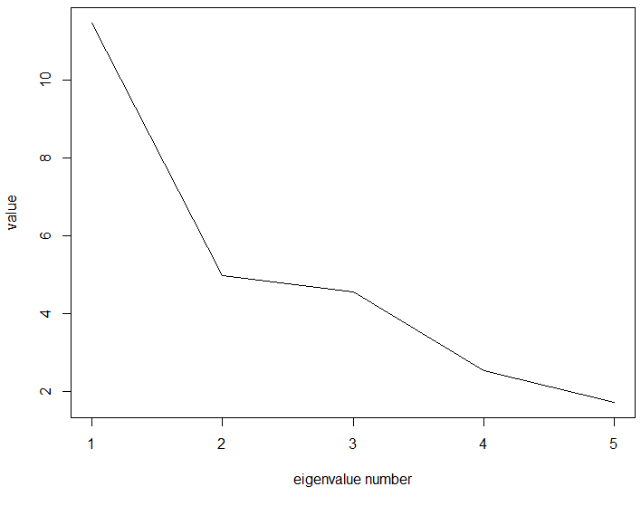
Interpretation of results

Slide 21
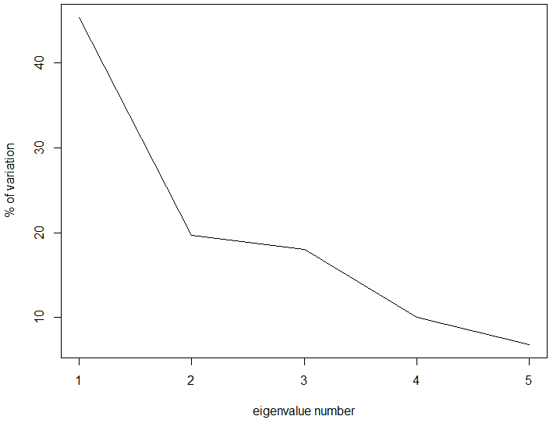
Interpretation of results
83%

Slide 22

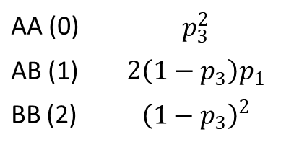
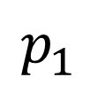
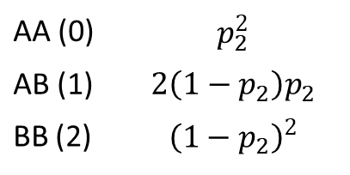
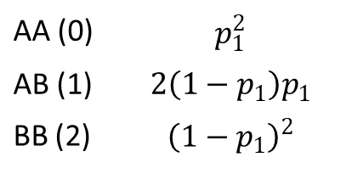
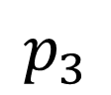
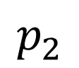
STRUCTURE/ADMIXTURE principles
(Unseen) frequency of allele A
In one SNP
(Unseen) Genotype frequencies
Observed genotype in individual i
Ancestral pops
0
$$p_{1}$$
AA (0) | $$p_{1}^{2}$$
AB (1) | $${2\left(1−p_{1}\right)p}_{1}$$
BB (2) | $${\left(1−p_{1}\right)}^{2}$$
1
$$p_{2}$$
AA (0) | $$p_{2}^{2}$$
AB (1) | $${2\left(1−p_{2}\right)p}_{2}$$
BB (2) | $${\left(1−p_{2}\right)}^{2}$$
2
3
$$p_{3}$$
AA (0) | $$p_{3}^{2}$$
AB (1) | $${2\left(1−p_{3}\right)p}_{1}$$
BB (2) | $${\left(1−p_{3}\right)}^{2}$$

Slide 23
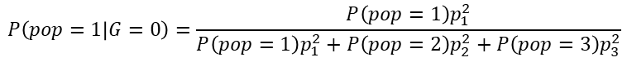
STRUCTURE/ADMIXTURE principles
(Unseen) frequency of allele A
In one SNP
(Unseen) Genotype frequencies
Observed genotype in individual i
Ancestral pops
0
$$p_{1}$$
AA (0) | $$p_{1}^{2}$$
AB (1) | $${2\left(1−p_{1}\right)p}_{1}$$
BB (2) | $${\left(1−p_{1}\right)}^{2}$$
1
$$P\left(pop=1 | G=0\right)=\frac{P\left(pop=1\right)p_{1}^{2}}{{P\left(pop=1\right)p}_{1}^{2}+P\left(pop=2\right)p_{2}^{2}+P\left(pop=3\right)p_{3}^{2}}$$
$$p_{2}$$
AA (0) | $$p_{2}^{2}$$
AB (1) | $${2\left(1−p_{2}\right)p}_{2}$$
BB (2) | $${\left(1−p_{2}\right)}^{2}$$
2
3
$$p_{3}$$
AA (0) | $$p_{3}^{2}$$
AB (1) | $${2\left(1−p_{3}\right)p}_{1}$$
BB (2) | $${\left(1−p_{3}\right)}^{2}$$

Slide 24

STRUCTURE/ADMIXTURE principles
If we have many SNVs, the probability of the vector of genotypes from a genome given a population is then computed as:
$$P\left(Genome|pop=i\right)=\prod_{s}^{n}{P\left(G_{s}|pop=i\right)}$$
Assumptions of this methodology?
Problem: what is the frequency of each SNP s in each population i?
Solution: given k individuals, estimate the probabilities of each SNV at each ancestral population so the likelihoods are maximized. There are different methods, such as the Expectation-Maximization algorithm. Nowadays the algorithms that follow this framework differ on the optimization method that is applied!

Slide 25
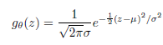
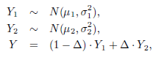



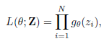
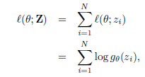
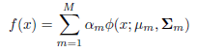
ADMIXTURE is a particular case of MIXTURE OF PROBABILITY DISTRIBUTIONS!
Imagine a single dimension (y)

Slide 26
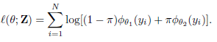
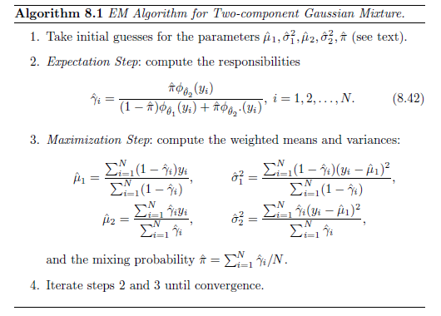
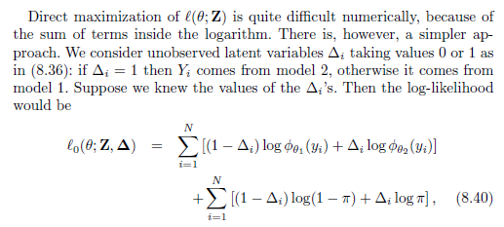
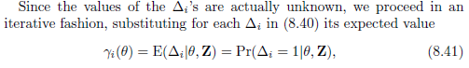
Gaussian mixture and EM algorithm
π = probability of being of the group 2

Slide 27
Gaussian mixture and EM algorithm
Probability that point i belongs to group 2 given the data
Prior probability of belonging to group 2
Likelihood of the data i in group 2
Weighted mean for group 1 (1-probability of assigning to group 2)
Weighted mean for group 2
Weighted variance for group 1 (1-probability of assigning to group 2)
Weighted variance for group 2

Slide 28
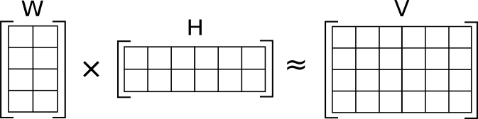
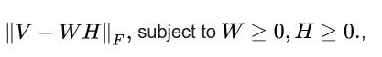
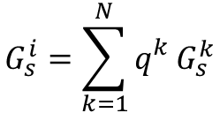
sNMF
For individual i and genotype G at SNPs, it can be considered a weighted average of the genotypes of the N ancestral populations.
Total number of ancestries
Frequency of genotype s in population k
$$G_{s}^{i}=\sum_{k=1}^{N}{q_{}^{k}G_{s}^{k}}$$
Genotype of individual i at SNP s
Weight of ancestry k
To minimize

Slide 29
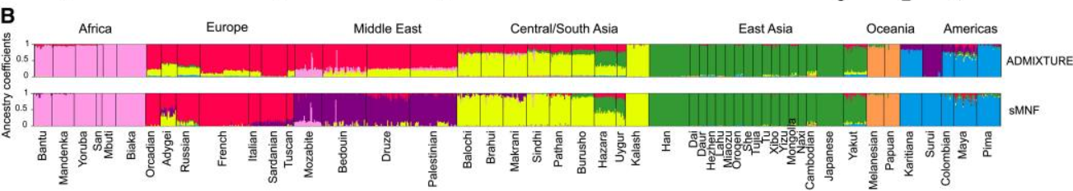
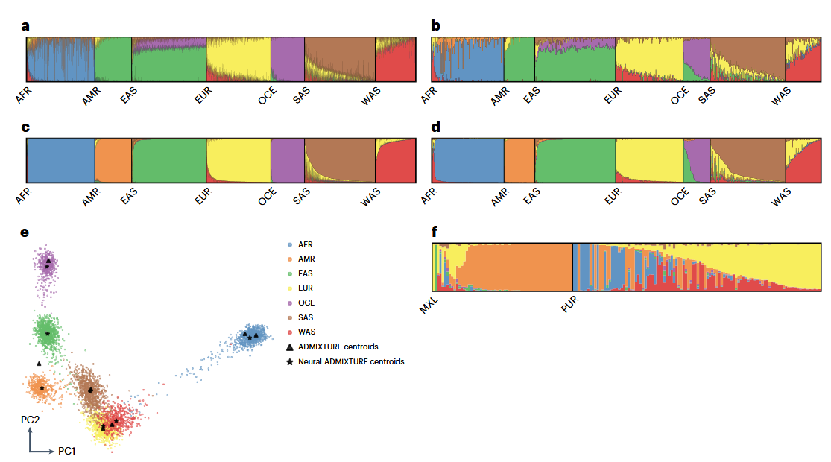
Guess what: different agorithms produce different results...
Genetics. 2014 Feb 4;196(4):973–983
ADMIXTURE vs Neural ADMIXTURE
Nature Computational Science volume 3, pages 621–629 (2023)

Slide 30
Global ancestry algorithms
Tool / Algorithm | Key Features | Input | Output | R Package / Software
STRUCTURE | Bayesian clustering, Q-matrix | Genotype matrix | Admixture proportions | structure
ADMIXTURE | Fast ML-based estimation | PLINK files | Admixture proportions | ADMIXTURE
fastSTRUCTURE | Scalable Bayesian via variational inference | Genotype matrix | Admixture proportions | fastSTRUCTURE (GitHub)
sNMF | Sparse non-negative matrix factorization | LFMM matrix | Ancestry proportions | LEA (CRAN)
PCA / MDS | Dimensionality reduction for structure visualization | SNP data | PCs per sample | SNPRelate or adegenet
fineSTRUCTURE + ChromoPainter | Haplotype-based clustering via coancestry matrix | Phased haplotypes | Coancestry matrix & clusters | fineSTRUCTURE
FST-based methods | Pairwise FST to quantify divergence | Allele frequencies | FST matrix | hierfstat (CRAN)
t-SNE / UMAP | Non-linear embedding of PCA results | PCA scores | Cluster visualization | Rtsne, umap
Neural Admixture | Deep Learning modelling | Genotype matrix | Admixture proportions | NeuralAdmixture (GitHub)

Slide 31
How many ancestral populations?

Slide 32
How many ancestral populations?
Identifying the OPTIMAL number of clusters depends on:
What do you understand by OPTIMAL?
How do you measure such “optimality”?
How do you explore the space of solutions to reach the optimal point (K)?

Slide 33
Change how data are defined. Local Ancestry
t1
t2
Recent events
Long tracks
……
tn
Old events
Short tracks

Slide 34
Change how data are defined. Local Ancestry
SNP1 ... SNPn
Possible parental populations
Inspired by slides from Leo Speidel

Slide 35
Change how data are defined. Local Ancestry
SNP1 ... SNPn
Painting
Possible parental populations
Inspired by slides from Leo Speidel

Slide 36
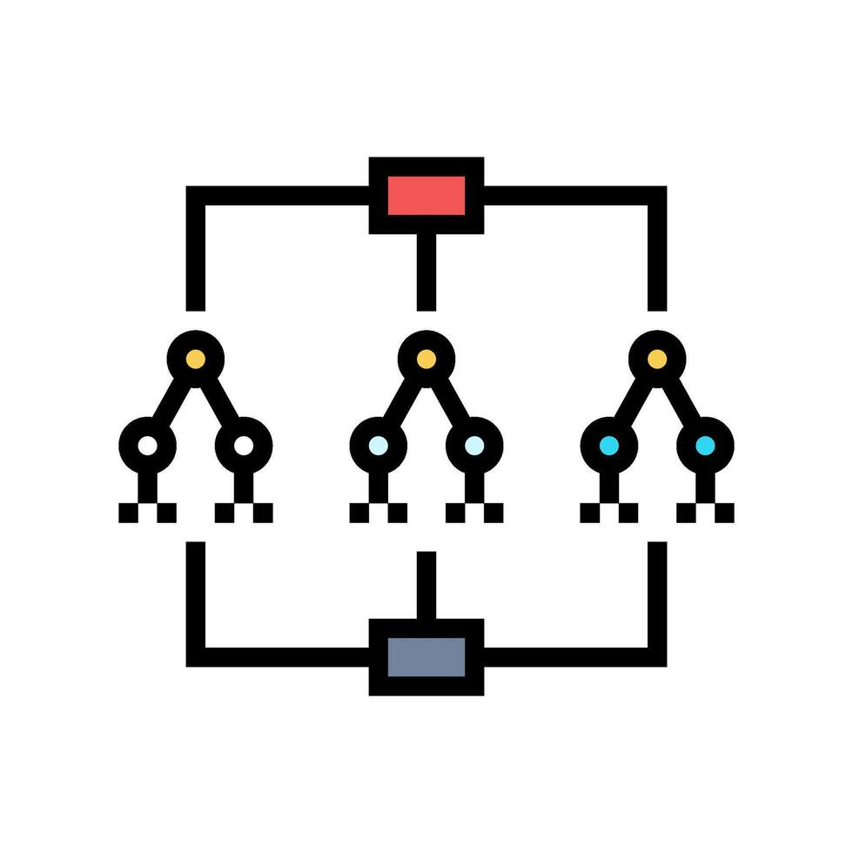
Local Ancestry. Estimated with Machine Learning methods
window
RFMix: Random Forest + Hidden Markov Model
Haplotypes ancestry blue
...
RF model combining multiple binary decission trees for predicting ancestry

Slide 37
Local Ancestry. Estimated with Machine Learning methods
window
RFMix: Random Forest + Hidden Markov Model
Haplotypes ancestry blue
...
RF model combining múltiple binary trees for predicting ancestry

Slide 38
Local Ancestry. Estimated with Machine Learning methods
window
RFMix: Random Forest + Hidden Markov Model
Haplotypes ancestry blue
...
RF model combining múltiple binary trees for predicting ancestry
...

Slide 39
Local Ancestry. Estimated with Machine Learning methods
window
RFMix: Random Forest + Hidden Markov Model
Haplotypes ancestry blue
...
RF model combining múltiple binary trees for predicting ancestry
...
HMM

Slide 40
Local Ancestry. Estimated with Machine Learning methods
...
Haplotype to LAI
...
Ancestry
In each RF
...
HMM
Reconstruction

Slide 41
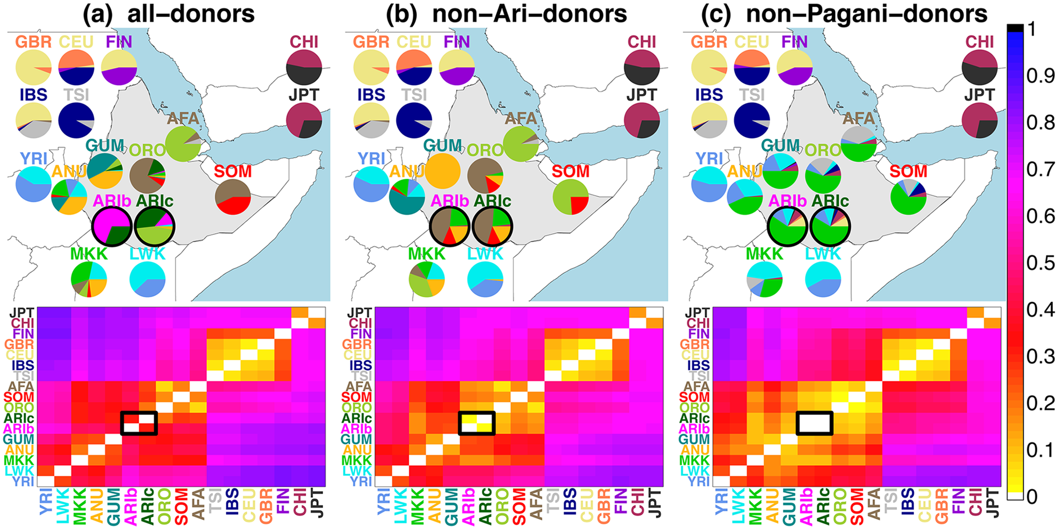
Change how data are defined. Local Ancestry
Chromopainter. Define who are the parents. Non-supervised: all; supervised: some-donnors
van Dorp et al, PLoS Genetics, 2015

Slide 42
Local ancestry algorithms
Tool / Algorithm | Key Features | Input | Output | R Package / Software
RFMix | HMM-based, phased data | Phased VCF + reference panel | Local ancestry per SNP | RFMix v2
ELAI | EM-based, handles multiple admixture pulses | Unphased genotypes | Ancestry probabilities | ELAI GitHub
LAMP / LAMP-LD | Window-based method; works with admixed populations | Genotype matrix | Ancestry blocks | LAMP (legacy)
Ancestry_HMM | HMM using recombination info, includes admixture timing | Phased haplotypes | Local ancestry + admixture time | Ancestry_HMM GitHub
HAPMIX (deprecated) | Two-way admixture model using HMM | Phased genotypes | Local ancestry states | HAPMIX (legacy)
WINPOP | PCA in sliding windows for non-model organisms | Unphased genotypes | Window-based ancestry assignments | winPop GitHub

Slide 43
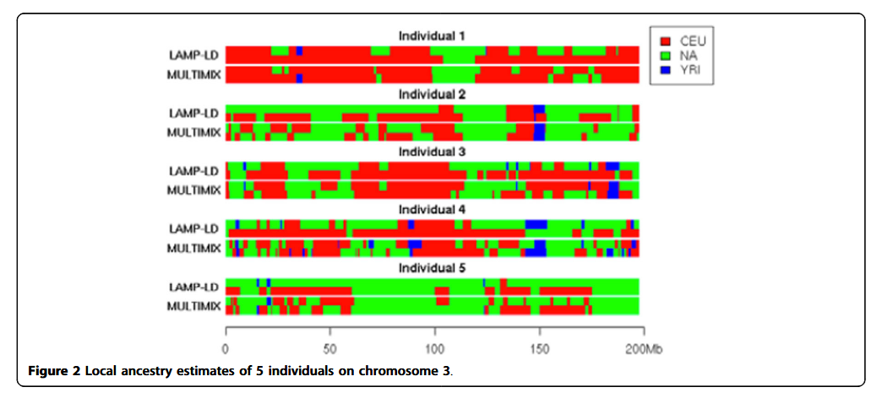
Local ancestry algorithms
Again, estimations can differ depending on the algorithm that is applied
BMC Proceedings 2014, 8(Suppl 1):S3

Slide 44
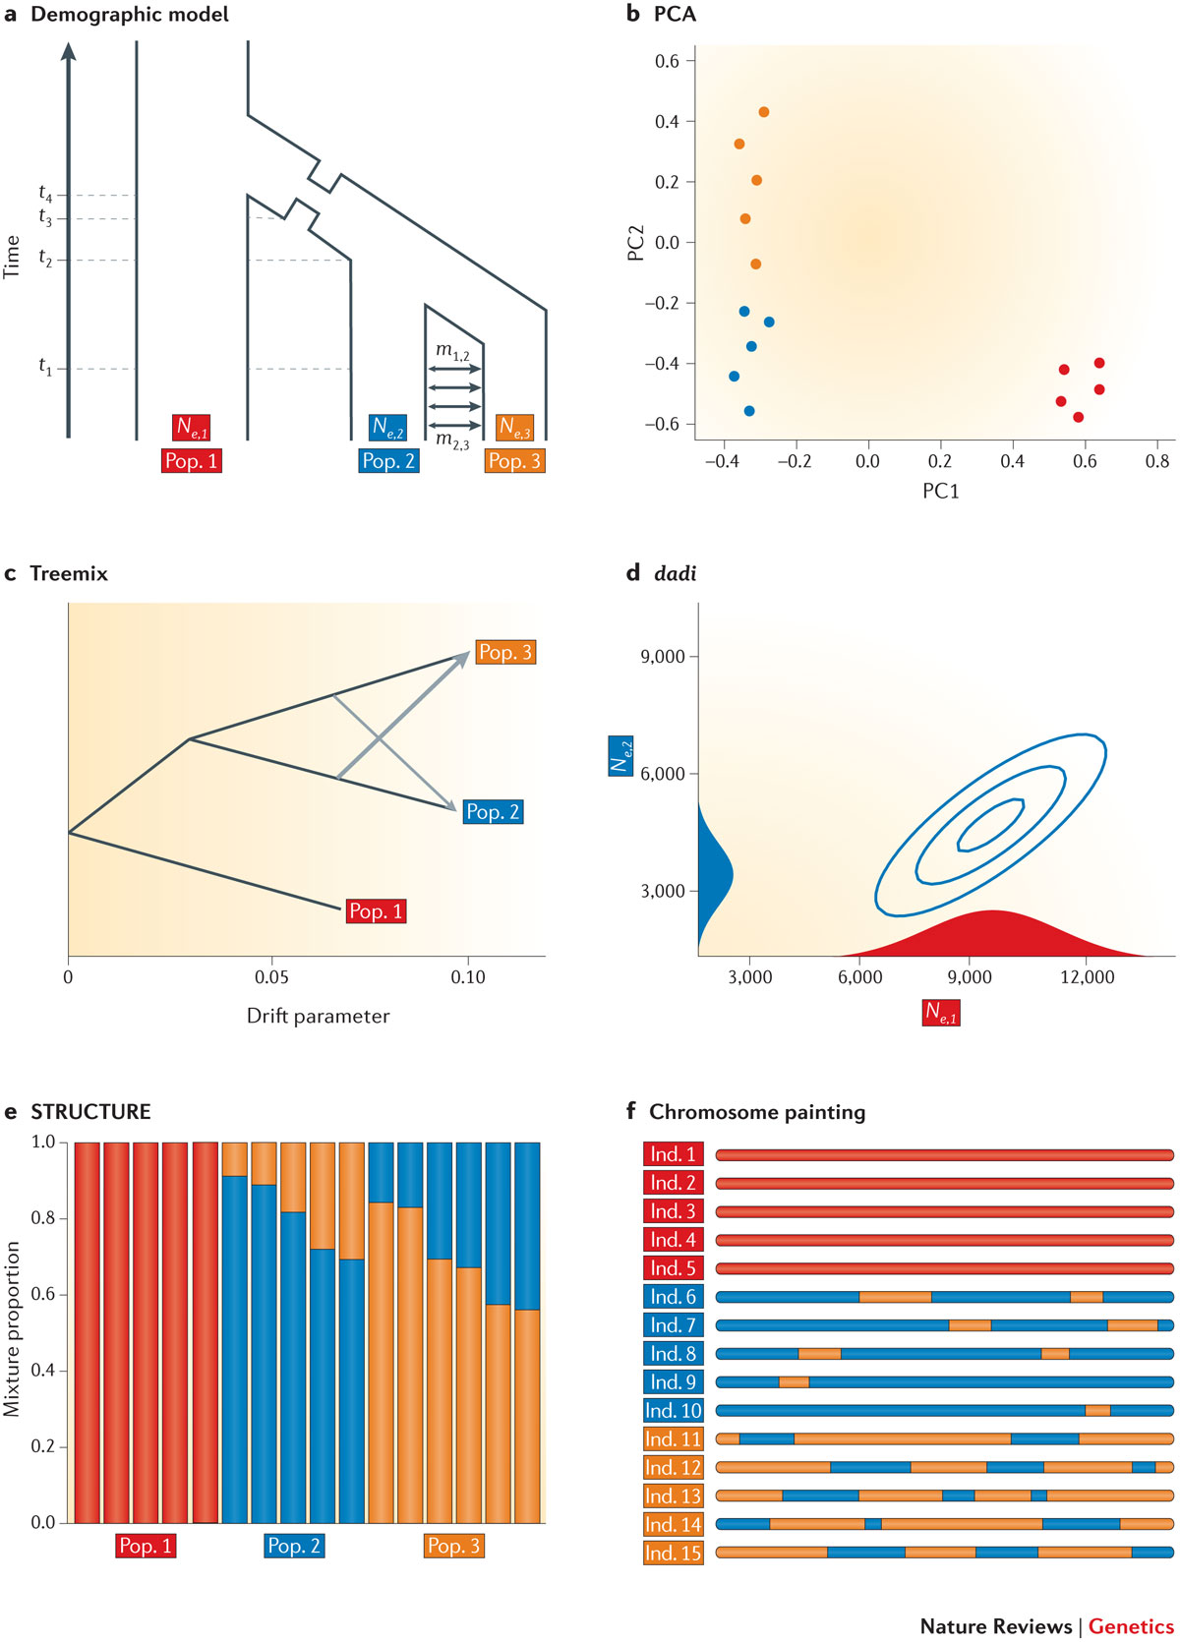
In summary

Slide 45
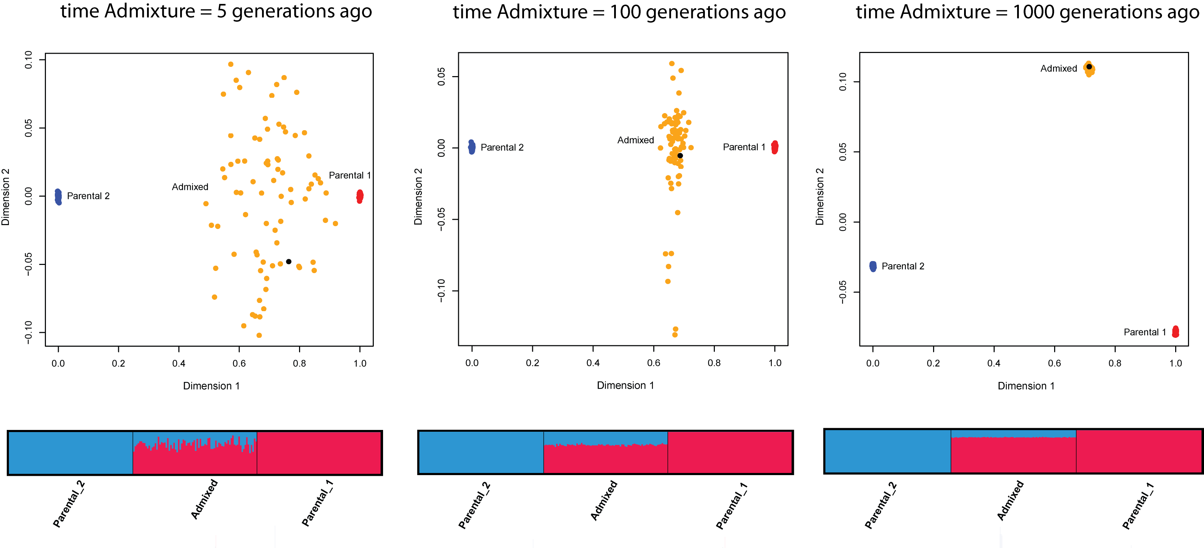
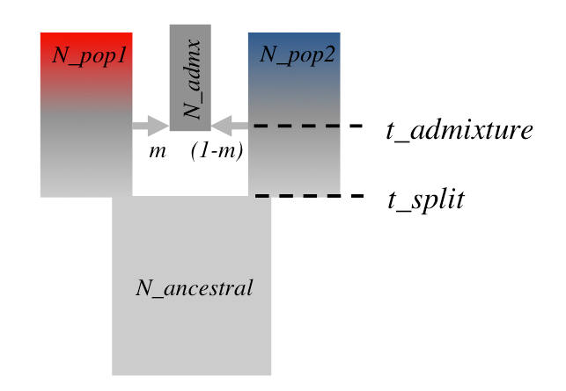
Ancestry estimation and demographic parameters?
Van Oven and Lao International Encyclopedia of Social and Behavioral Sciences 2nd Edition

Slide 46
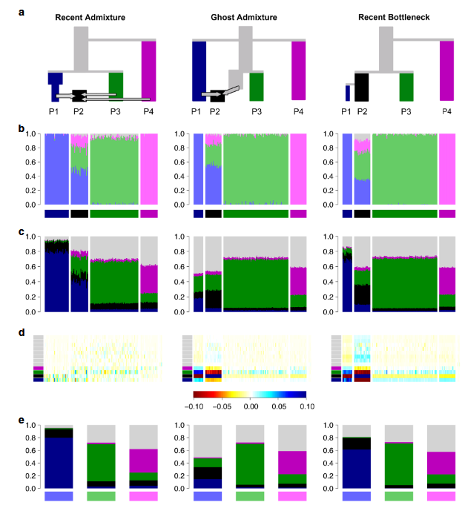
Ancestry estimation and demographic parameters?
Lawson, van Dorp & Falush. Nat Comms. (2018).

Slide 47
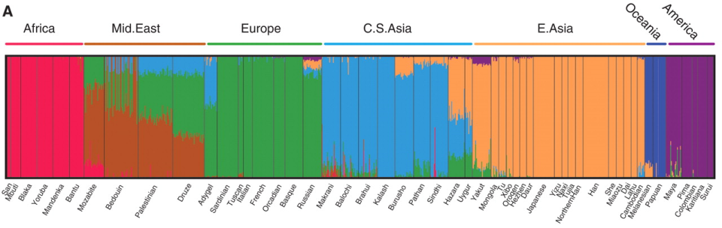
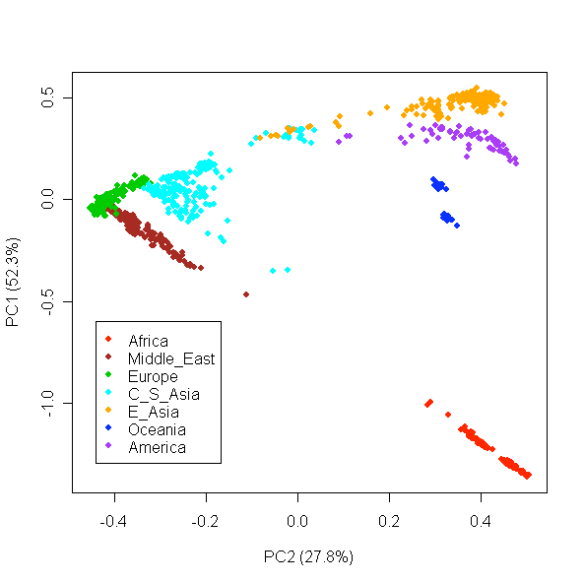
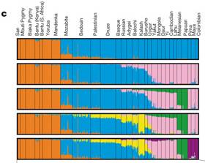
Interpretation
FRAPPE
HGDP-CEPH panel
650,000 SNPs
Li et al Science 2008
550,000 SNPs
STRUCTURE
Jakobsson et al Nature 2008
Li et al Science 2008

Slide 48
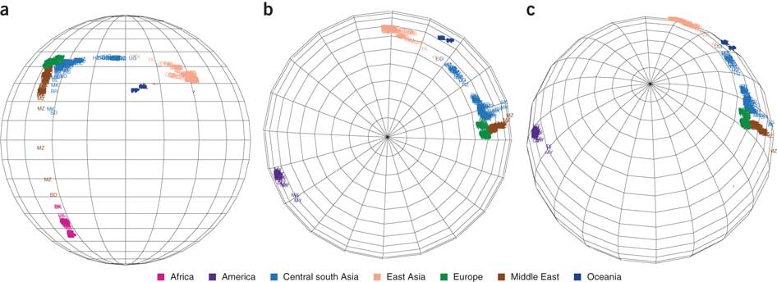
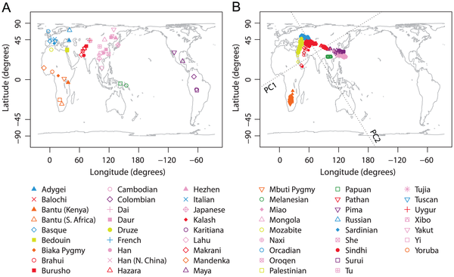
Interpretation
Yang et al (2012) Nature Genetics
Wang C et al (2012) PLoS Genet

Slide 49
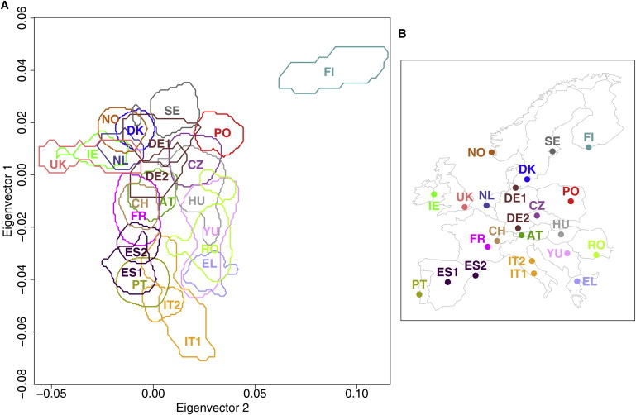
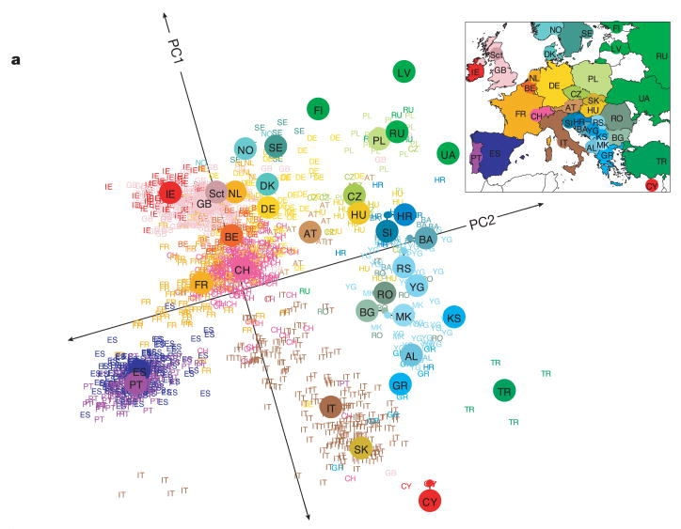
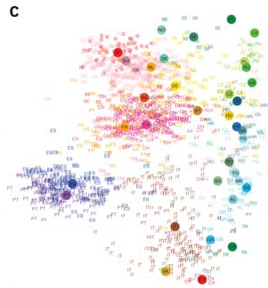
European genetic substructure
Novembre et al 2007 Nature
Lao et al 2007 Current Biology
Yang et al (2012) Nature Genetics

Slide 50
Takehome messages
Ancestry estimation is a subfield of Machine learning
Feature extraction: Unsupervised learning methods that compresses information of features. In the case of genetic data, genetic variation. PCA, ADMIXTURE, sNMF…
Demographic interpretation can be challenging. BEWARE STORY TELLING!
Local ancestry focus on LD. They are supervised or semi-supervised machine learning methods. They usually build ML models at loci and HMM to connect adjacent loci
Local ancestry can be used to identify recent admixture events
REMEMBER: results will depend on the assumptions of the algorithms!

Slide 51

Thank you very much!
oscar.lao@ibe.upf-csic.es

